Slide 1
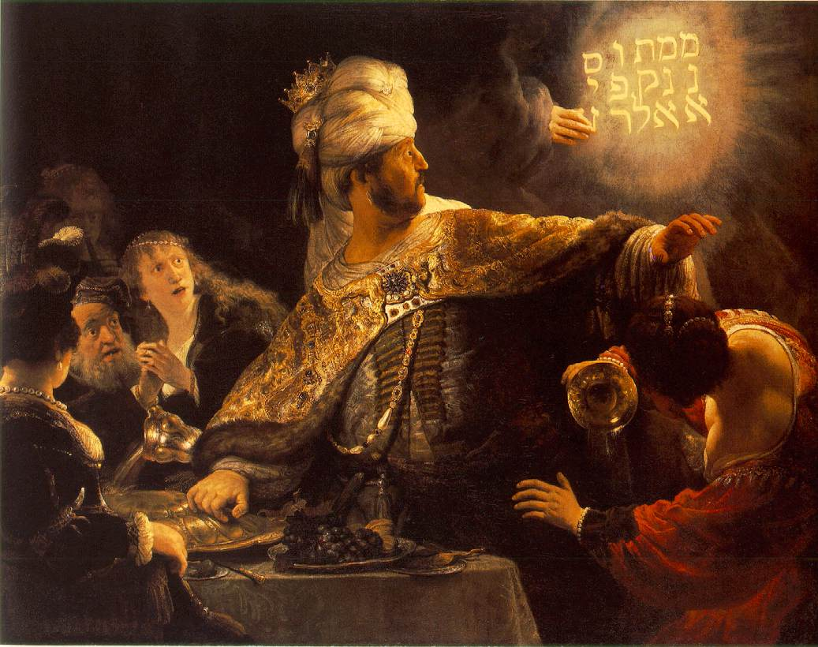
This is my father’s world
The story of
Belshazzar
How human kingdoms rise and fall

Slide 2
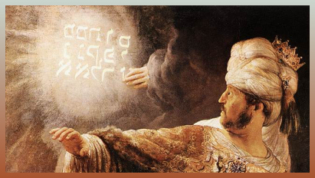
From mina, 50 shekels
Derived from verb, “to number”
God is the one who determines which kingdoms survive and which do not
Mene
God has numbered your kingdom, and put an end to it.
(Daniel 5:26)
Notes:
It began with God
It was formed by God
It was revealed through God
It was subjected to God

Slide 3
From shekel, the standard coin
Derived from verb, “to weigh”
God has specific expectations of rulers and governments
Tekel
You have been weighed on the scales and found deficient.
(Daniel 5:26)
Notes:
It began with God
It was formed by God
It was revealed through God
It was subjected to God

Slide 4
Plural of peres, the half-shekel
Derived from verb, “to divide”
God will dispose of human governments as He sees fit
Upharsin
Your kingdom has been divided and given over to the Medes and Persians.
(Daniel 5:26)
Notes:
It began with God
It was formed by God
It was revealed through God
It was subjected to God

Slide 5
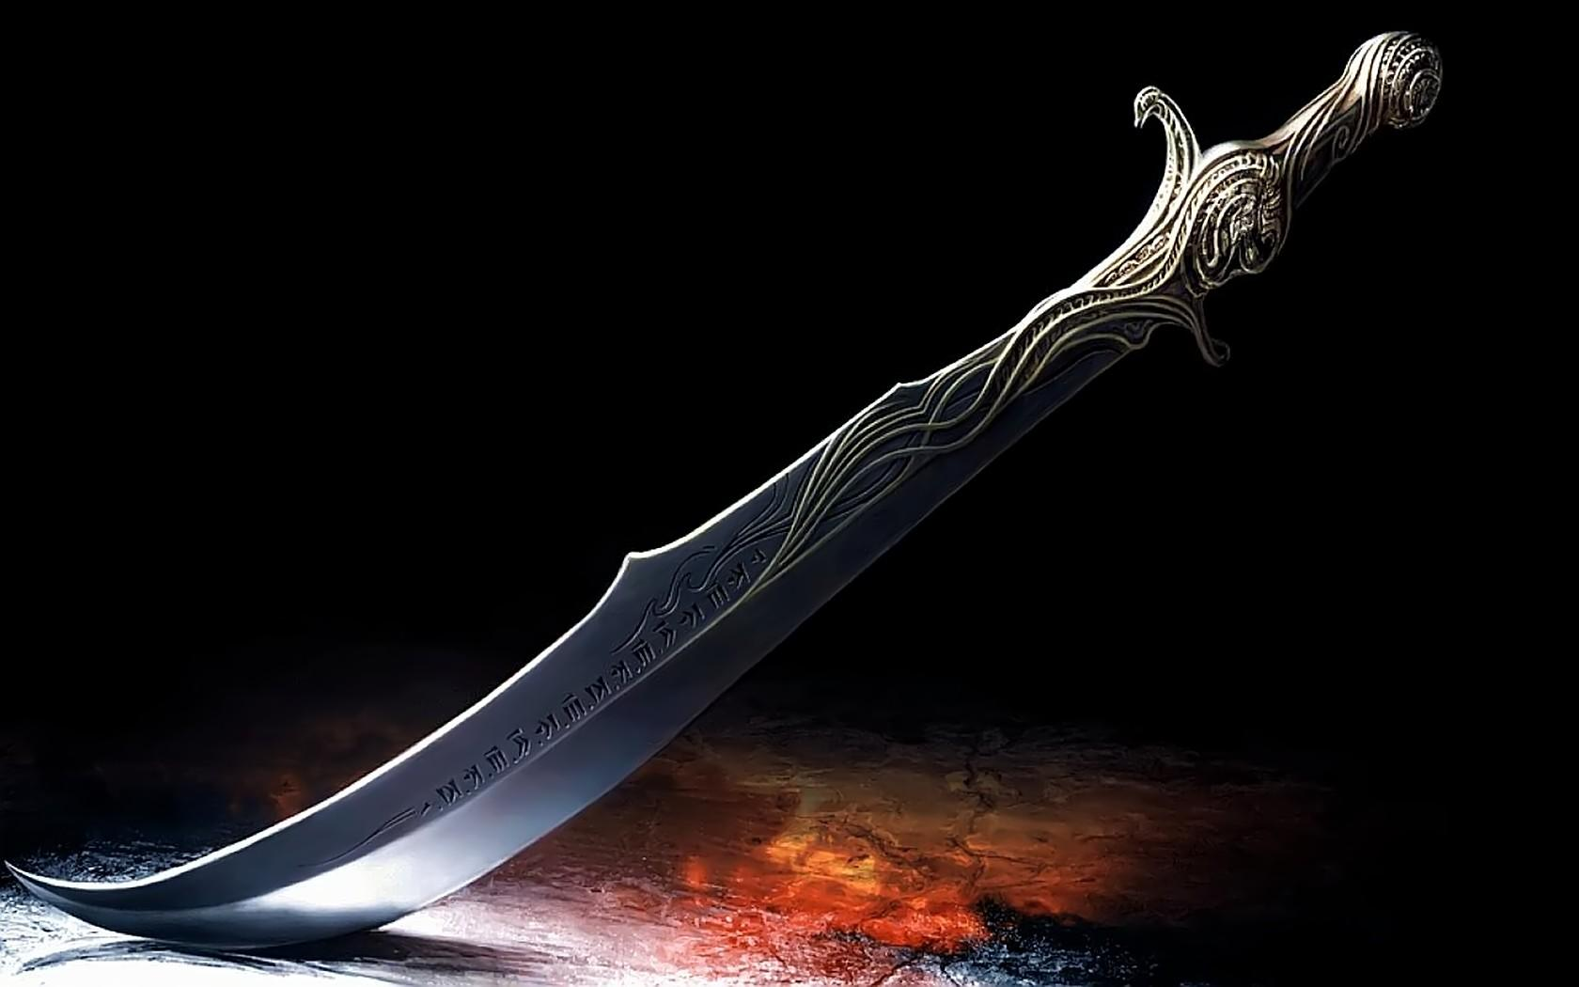
The power God provides is used …
To crush others (Daniel 5:18-19)
To vaunt themselves (Daniel 5:20)
To flaunt their immorality (Daniel 5:23)
Such behavior denies accountability toward a far greater power (2 Corinthians 5:10)
Such ones will be “weighed on the scales and found deficient” (Daniel 5:27)
Notes:
It began with God
It was formed by God
It was revealed through God
It was subjected to God

Slide 6
Power should be used …
To honor God
  “The kings of the earth take their stand and the rulers take counsel together against the Lord and against His Anointed, saying, ‘Let us tear their fetters apart and cast away their cords from us!’ … Now therefore, O kings, show discernment; take warning, O judges of the earth. Worship the Lord with reverence and rejoice with trembling.” (Psalm 2:2-3, 10-11)
Notes:
Trust in God, not government – Psalm 146:3-4

Slide 7
Power should be used …
To protect the vulnerable
  “Give the king Your judgments, O God, and Your righteousness to the king’s son. May he judge your people with righteousness and Your afflicted with justice. Let the mountains bring peace to the people, and the hills, in righteousness. May he vindicate the afflicted of the people, save the children of the needy and crush the oppressor.” (Psalm 72:1-4)
Notes:
Trust in God, not government – Psalm 146:3-4

Slide 8
Power should be used …
To fight evil
  “For rulers are not a cause of fear for good behavior, but for evil. … But if you do what is evil, be afraid; for it does not bear the sword for nothing; for it is a minister of God, an avenger who brings wrath on the one who practices evil.” (Romans 13:3-4)
“The lowliest of men” can and do accomplish the greatest of tasks (Daniel 4:16-17)
Notes:
Trust in God, not government – Psalm 146:3-4

Slide 9

How does America stack up?
Do we honor God when we refuse to have Him glorified in the public square?
Do we protect the vulnerable when we abort a million babies a year?
Do we fight evil when we legalize and mainstream all sorts of wicked behavior?
The “lowliest” among us has a part to play
Notes:
Trust in God, not government – Psalm 146:3-4

Slide 10

How do WE stack up?
Do we honor God?
  “I will give thanks to You, O Lord my God, with all my heart, and will glorify Your name forever.” (Psalm 86:12)
  “’A son honors his father, and a servant his master. Then if I am a father, where is My honor? And if I am a master, where is My respect?’ says the Lord of hosts to you, O priests …” (Malachi 1:6)
Notes:
Trust in God, not government – Psalm 146:3-4

Slide 11
How do WE stack up?
Do we protect the vulnerable?
  “Those who are sickly you have not strengthened, the diseased you have not healed, the broken you have not bound up, the scattered you have not brought back, nor have you sought for the lost; but with force and with severity you have dominated them.” (Ezekiel 34:4)
Notes:
Trust in God, not government – Psalm 146:3-4

Slide 12
How do WE stack up?
Do we fight evil?
  “We are destroying speculations and every lofty thing raised up against the knowledge of God, and we are taking every thought captive to the obedience of Christ” (2 Corinthians 10:5)
  “Finally, be strong in the Lord and in the strength of His might. Put on the full armor of God, so that you will be able to stand firm against the schemes of the devil.” (Ephesians 6:10-11)
Notes:
Trust in God, not government – Psalm 146:3-4

Slide 13
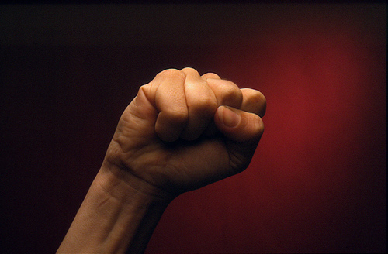
To those who rebel: Do Not …
Forget the One who gave you what you have (Jeremiah 18:5-11)
Mistake comfort for safety (Amos 6:1-2)
Assume “better than them” is good enough (Habakkuk 1:5-7)
Wait for worst-case scenarios to repent (Micah 3:1-4)
Notes:
Trust in God, not government – Psalm 146:3-4

